Slide 1
THE LIFE OF CHRIST
PART 66

Slide 2
Bromling says that “parables are often defined as earthly stories with heavenly meanings.

Slide 3
“Bernard Ramm points out that there are four elements to a parable. First, there is an earthly event, thing, or custom. This would be something very familiar to the audience. It might deal with business, farming, family, social events, etc. This earthly part of the parable must be rooted in reality. Events must actually happen or be capable of actually happening. Second, there is a spiritual lesson which the parable intends to teach. Third, the earthly element has an analogical relationship to the spiritual element. Fourth, because the parable has two levels of meaning, there is need of interpretation.

Slide 4
Luke 16:9 " There was a certain rich man who was clothed in purple and fine linen and fared sumptuously every day. ²⁰ "But there was a certain beggar named Lazarus, full of sores, who was laid at his gate, ²¹ "desiring to be fed with the crumbs which fell from the rich man's table. Moreover the dogs came and licked his sores. ²² "So it was that the beggar died, and was carried by the angels to Abraham's bosom. The rich man also died and was buried. ²³ "And being in torments in Hades, he lifted up his eyes and saw Abraham afar off, and Lazarus in his bosom.

Slide 5
²⁴ "Then he cried and said, 'Father Abraham, have mercy on me, and send Lazarus that he may dip the tip of his finger in water and cool my tongue; for I am tormented in this flame.' ²⁵ "But Abraham said, 'Son, remember that in your lifetime you received your good things, and likewise Lazarus evil things; but now he is comforted and you are tormented. ²⁶ 'And besides all this, between us and you there is a great gulf fixed, so that those who want to pass from here to you cannot, nor can those from there pass to us.' ²⁷ "Then he said, 'I beg you therefore, father, that you would send him to my father's house,

Slide 6
²⁸ 'for I have five brothers, that he may testify to them, lest they also come to this place of torment.' ²⁹ "Abraham said to him, 'They have Moses and the prophets; let them hear them.' ³⁰ "And he said, 'No, father Abraham; but if one goes to them from the dead, they will repent.' ³¹ "But he said to him, 'If they do not hear Moses and the prophets, neither will they be persuaded though one rise from the dead.' "

Slide 7
Luke 16:9 Now there was a certain rich man, and he was clothed in purple and fine linen, faring sumptuously every day:

Slide 8
Purple (porphuran). This purple dye was obtained from the purple fish, a species of mussel or murex (1Macc. 4:23). It was very costly and was used for the upper garment by the wealthy and princes (royal purple). They had three shades of purple (deep violet, deep scarlet or crimson, deep blue). See also Mr 15:17,20; Re 18:12.
Fine linen (busson). Byssus or Egyptian flax (India and Achaia also). It is a yellowed flax from which fine linen was made for undergarments. It was used for wrapping mummies. "Some of the Egyptian linen was so fine that it was called woven air" (Vincent).

Slide 9
²⁰ and a certain beggar named Lazarus was laid at his gate, full of sores, ²¹ and desiring to be fed with the crumbs that fell from the rich man's table; yea, even the dogs come and licked his sores.

Slide 10
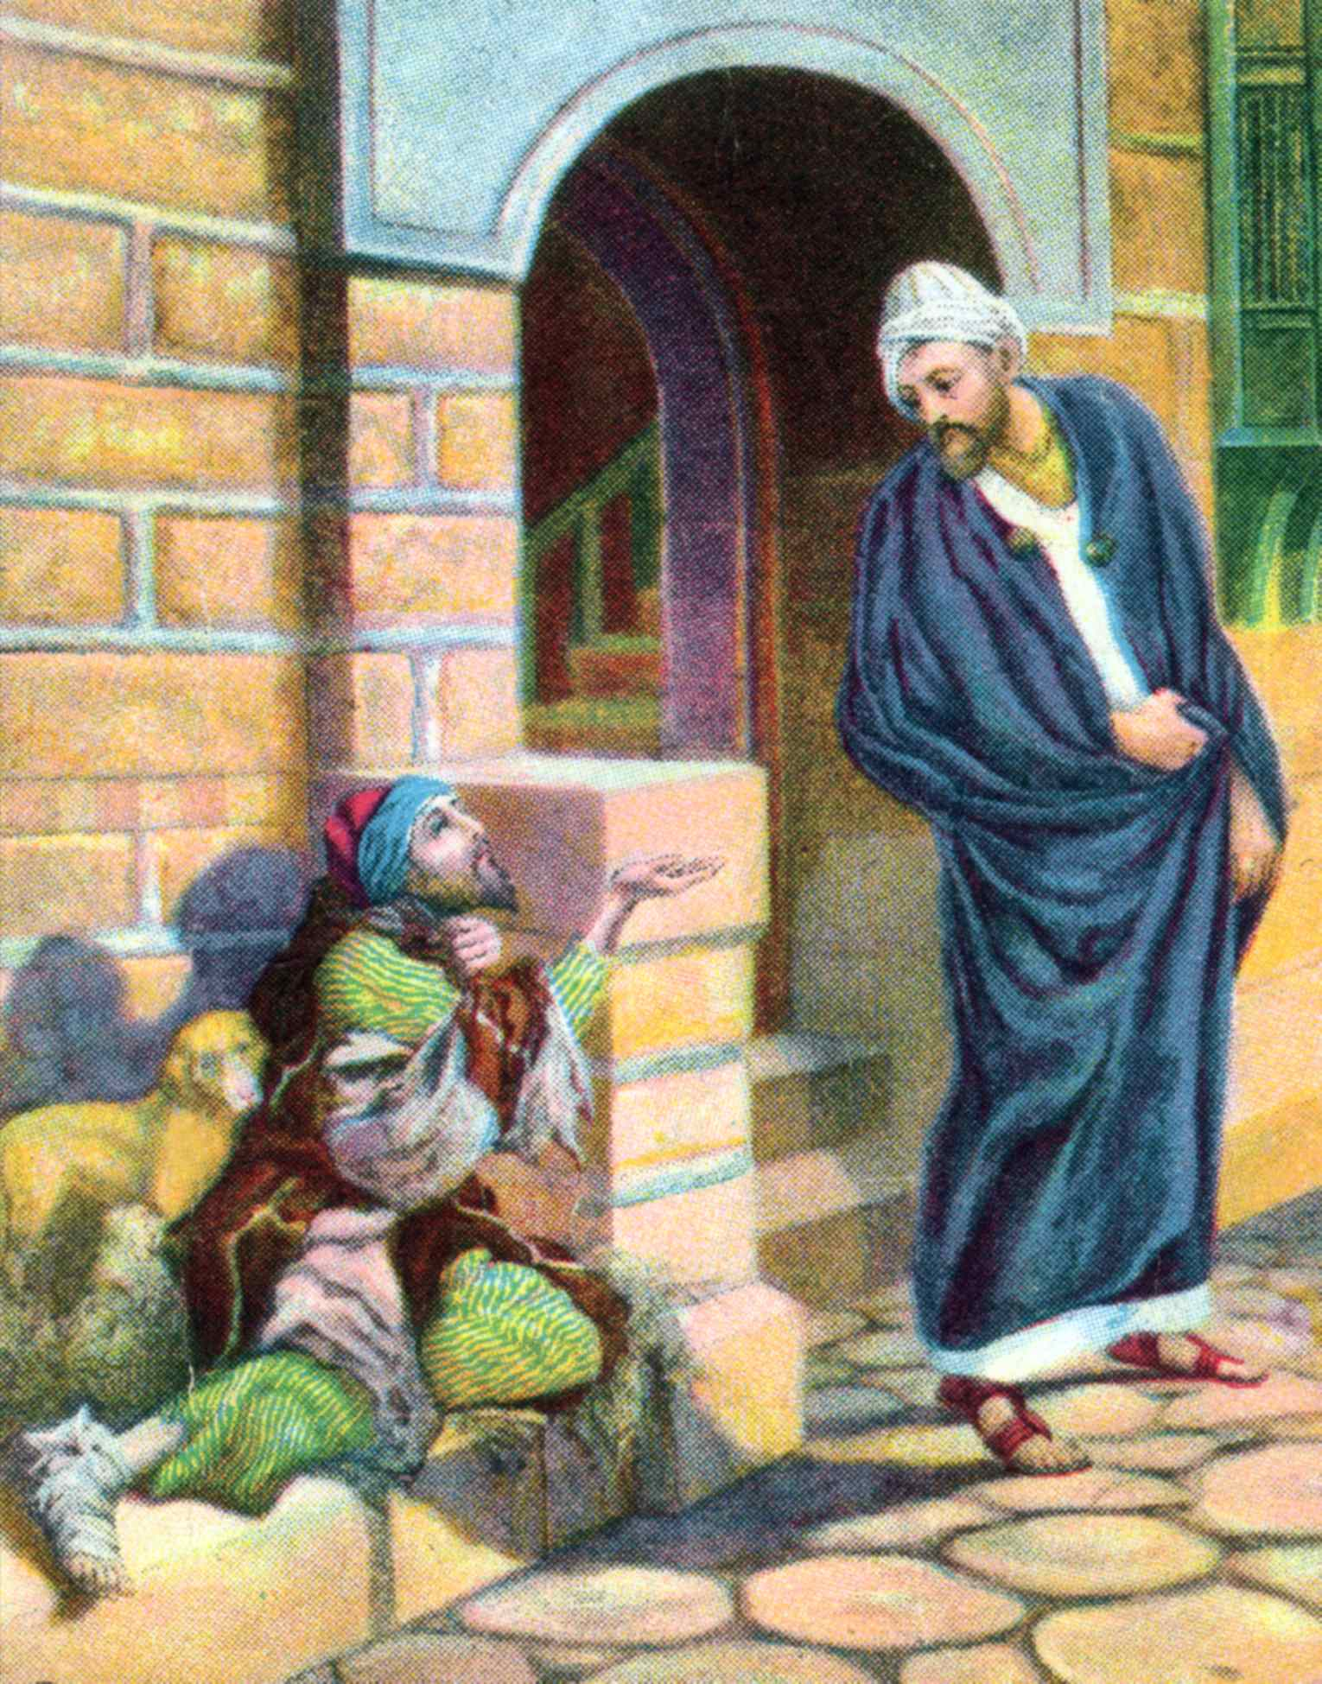

Slide 11
²² And it came to pass, that the beggar died, and that he was carried away by the angels into Abraham's bosom: and the rich man also died, and was buried.

Slide 12
1 Timothy 6:6 Now godliness with contentment is great gain. ⁷ For we brought nothing into this world, and it is certain we can carry nothing out.
Ecclesiastes 5:15 As he came from his mother's womb, naked shall he return, To go as he came; And he shall take nothing from his labor Which he may carry away in his hand.

Slide 13
²³ And in Hades he lifted up his eyes, being in torments, and seeth Abraham afar off, and Lazarus in his bosom. ²⁴ And he cried and said, Father Abraham, have mercy on me, and send Lazarus, that he may dip the tip of his finger in water, and cool my tongue; for I am in anguish in this flame. ²⁵ But Abraham said, Son, remember that thou in thy lifetime receivedst thy good things, and Lazarus in like manner evil things: but now here he is comforted and thou art in anguish. ²⁶ And besides all this, between us and you there is a great gulf fixed, that they that would pass from hence to you may not be able, and that none may cross over from thence to us.

Slide 14
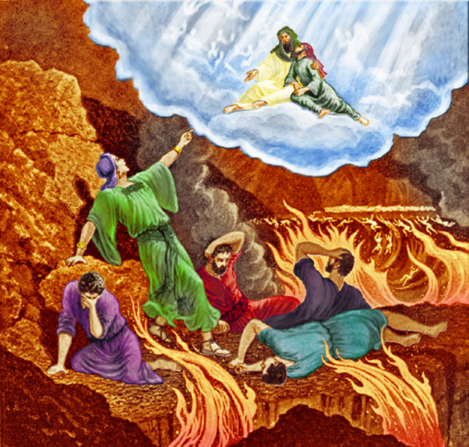

Slide 15
²⁷ "Then he said, 'I beg you therefore, father, that you would send him to my father's house, ²⁸ 'for I have five brothers, that he may testify to them, lest they also come to this place of torment.' ²⁹ "Abraham said to him, 'They have Moses and the prophets; let them hear them.' ³⁰ "And he said, 'No, father Abraham; but if one goes to them from the dead, they will repent.' ³¹ "But he said to him, 'If they do not hear Moses and the prophets, neither will they be persuaded though one rise from the dead.' "

Slide 16
Our material possession and daily comfort can be deceiving and cause us to think that we are blessed and right with God when we are not.
We can become so concerned about ourselves, that we neglect those who need our help, which will not be good for our eternity as Jesus points in the last part Matthew 25.
Just because you have done well to be prepared for the future on this earth, it does not mean that you have done well to prepare for your future in eternity.

Slide 17
Just because we have not done well here on earth, does not mean that we have done well in preparing ourselves for heaven.
Death comes to us all, rich and poor.
When we die, our spirit will be taken to either Abraham’s bosom also called Paradise, or we will end up where the rich man is in the place of torment also called tartartos. Once we are there, there is no leaving until the final judgment day. Those like the rich man will find their final home in hell for eternity and those like Lazarus will be in heaven for eternity.
Finally, we learn that God’s Word is sufficient for us and it tells us everything we need to know to be right with God and to make sure that heaven will be our home.

Slide 18
If this is a parable, it is the only one that names a person, which is Lazarus.
As noted earlier, a parable was an earthly story with a heavenly meaning. However, Jesus describes Hades, which no one would have a clear understanding of because it is something beyond that of the physical. So, Hades does not in any way fit the criteria of a parable. However, Jesus knows about Hades and He is giving a real glimpse into this place through this actual event He tells us about.
What exactly would Hades represent other than Hades itself? If it were a parable, it would represent something else.

Slide 19
Luke 17:1 Then He said to the disciples, "It is impossible that no offenses should come, but woe to him through whom they do come! ² "It would be better for him if a millstone were hung around his neck, and he were thrown into the sea, than that he should offend one of these little ones.

Slide 20
Luke 17:3 "Take heed to yourselves. If your brother sins against you, rebuke him; and if he repents, forgive him. ⁴ "And if he sins against you seven times in a day, and seven times in a day returns to you, saying, 'I repent,' you shall forgive him."

Slide 21
Luke 17:5 And the apostles said to the Lord, "Increase our faith."

Slide 22
He did mention their lack of faith on may occasions such as in Mt. 14:31; 17; 14-23; Mk. 4:40 and John20:27. John 20:27.
Luke 17:6 So the Lord said, "If you have faith as a mustard seed, you can say to this mulberry tree, 'Be pulled up by the roots and be planted in the sea,' and it would obey you.

Slide 23
Luke 17:7 "And which of you, having a servant plowing or tending sheep, will say to him when he has come in from the field, 'Come at once and sit down to eat'? ⁸ "But will he not rather say to him, 'Prepare something for my supper, and gird yourself and serve me till I have eaten and drunk, and afterward you will eat and drink'? ⁹ "Does he thank that servant because he did the things that were commanded him? I think not. ¹⁰ "So likewise you, when you have done all those things which you are commanded, say, 'We are unprofitable servants. We have done what was our duty to do.' "

Slide 24
As Christians, we are not supposed to look back, we are to keep our focus on moving forward Lk 9:62
We are to be a pattern of good works Titus 2:7.
We are to be zealous for good works Titus 2:14.
We are created in Christ Jesus for good works Ephesians 2:10.
Faith without works is dead James 2:20.

Slide 25
Revelation 14:13 Then I heard a voice from heaven saying to me, "Write: 'Blessed are the dead who die in the Lord from now on.' " "Yes," says the Spirit, "that they may rest from their labors, and their works follow them."

Slide 26
Well done, good and faithful servant; you have been faithful over a few things, I will make you ruler over many things. Enter into the joy of your lord. Mat 25:23.

